Slide 1
CLOUD COMPUTING
BY- SUNIL KUMAR

Slide 2
What is Cloud ?
The term Cloud refers to a Network or Internet. In other words, we can say that Cloud is something, which is present at remote location. Cloud can provide services over network, i.e., on public networks or on private networks. Applications such as e-mail, chat services ,online data storage platform all run in cloud.

Slide 3
What is cloud computing?
Cloud Computing means by which we can access the applications or any kind of data over the Internet. It allows us to create, configure, and customize applications online.
Cloud Computing refers to manipulating, configuring, and accessing the applications online. It offers online data storage on the web servers.

Slide 4
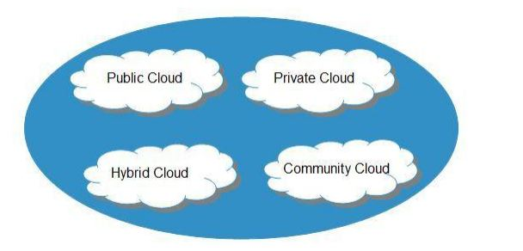
Types of cloud
Public cloud
Private cloud
Hybrid cloud
Community cloud

Slide 5
Public cloud
The Public Cloud allows systems and services to be easily accessible to the general public. Public cloud may be less secure because of its openness, e.g. e-mail.
For egg. Google docs.

Slide 6
Private cloud
The Private Cloud allows systems and services to be accessible within an organization. It offers increased security because of its private nature.
For egg. Ibm cloud

Slide 7
Hybrid cloud
The Hybrid Cloud is mixture of public and private cloud. However, the critical activities are performed using private cloud while the non-critical activities are performed using public cloud.

Slide 8
COMMUNITY CLOUD
The Community Cloud allows systems and services to be accessible by group of organizations

Slide 9
SERVICE MODELS
Infrastructure as a Service (IaaS)
Platform as a Service (PaaS)
Software as a Service (SaaS)

Slide 10
Infrastructure as a Service (IaaS)
IaaS provides the infrastructure such as virtual machines and other resources like virtual-machine disk image library, block and file-based storage, firewalls, load balancers, IP addresses, virtual local area networks etc.
For egg. Amazon Web Services, Microsoft Azure.

Slide 11
Platform as a Service (PaaS)
platform as a service model provides you computing platforms which typically includes operating system, programming language execution environment, database, web server. technically It is a layer on top of IaaS as the second thing you demand after Infrastructure is platform.
FOR EGG. Windows Azure.

Slide 12
Software as a Service (SaaS)
In a SaaS you are provided access to application services installed at a server. You don’t have to worry about installation, maintenance or coding of that software. You can access and operate the software with just your browser. You don’t have to download or install any kind of setup or OS, the software is just available for you to access and operate.
For egg. Google Apps, Google docs, Gmail.

Slide 13
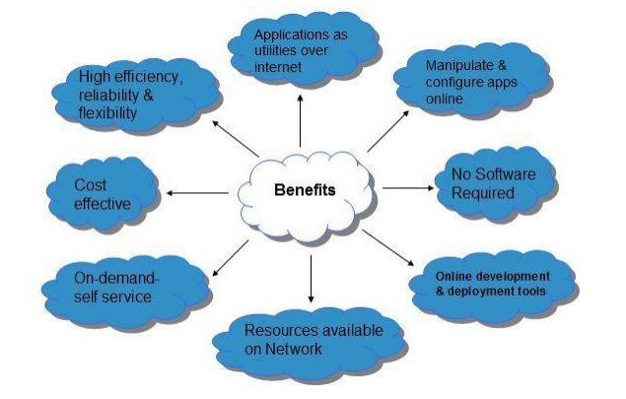
Benefits or characteristic of cloud computing

Slide 14
Puzzles
1 What word is missing from this sequence:
begin inch chapel elastic…………cellar arisen end ?

Slide 15
Answer: Ice
Logic: Each word begins with the last two letters of the previous word.

Slide 16
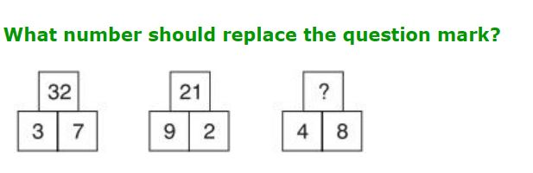

Slide 17
Ans is 18.
Sol. Multiply the bottom numbers to obtain the numbers at the top, albeit they are at the top of a different pyramid.

Slide 18
THANK YOU

